Slide 1

Diabetes Diagnosis Project
This project aims to develop a machine learning model for diagnosing diabetes using a comprehensive dataset of health and demographic information. The team, consisting of Mohamed waleed, Mahmoud Habib, Abdelrahman Zayan, has created a predictive model for diabetes risk assessment.
The project encompasses data preprocessing, feature engineering, model development. By leveraging a dataset of 100,000 individuals' health records, the team has developed insights and a practical tool for early diabetes diagnosis.

Slide 2



Introduction
IMPORTANCE OF EARLY DIABETES DIAGNOSIS
MACHINE LEARNING FOR DIABETES PREDICTION
PRIORITIZING RECALL AND AUC-PR
Focusing on high recall and AUC-PR metrics to minimize the number of false negatives, ensuring high-risk individuals are correctly identified.
Early diagnosis allows for prompt treatment and management, reducing the risk of complications such as blindness, kidney failure, and cardiovascular disease.
Leveraging health and demographic data to build predictive models that can identify individuals at risk of developing diabetes.
EARLY AND ACCURATE DIABETES DIAGNOSIS IS CRUCIAL FOR EFFECTIVE MANAGEMENT AND PREVENTION OF SERIOUS COMPLICATIONS. BY UTILIZING MACHINE LEARNING MODELS THAT PRIORITIZE KEY PERFORMANCE METRICS, HEALTHCARE PROFESSIONALS CAN MAKE INFORMED DECISIONS AND PROVIDE TIMELY INTERVENTIONS.

Slide 3

Project Overview and Methodology
The project utilizes a dataset from Kaggle, comprising health and demographic data of 100,000 individuals. Key features include age, gender, race, BMI, blood glucose level, HbA1c, hypertension, heart disease, and smoking history.
The methodology involved data preprocessing, including removal of outliers and duplicate entries, handling missing values, and feature engineering. encoded categorical variables for machine learning models.
Data Preprocessing
1
Removal of outliers, handling missing values, feature engineering
Model Development
2
Selection and training of machine learning models

Slide 4



Data Preprocessing
ENCODING CATEGORICAL VARIABLES
HANDLING CLASS IMBALANCE
HANDLING MISSING DATA
Identified missing values in the dataset and implemented strategies like mean/median imputation or dropping rows with missing data to ensure the dataset is complete and ready for further analysis.
Converted categorical variables into numerical formats, such as one-hot encoding or label encoding, to allow the machine learning algorithms to interpret and process the data effectively.
The dataset had a significant imbalance between the diabetic and non-diabetic cases. To address this, we used under-sampling, where the majority class (non-diabetic cases) was reduced to match the size of the minority class (diabetic cases). This resulted in a balanced dataset, with both classes having 7,000 samples each, allowing the model to learn from both classes equally.

Slide 5
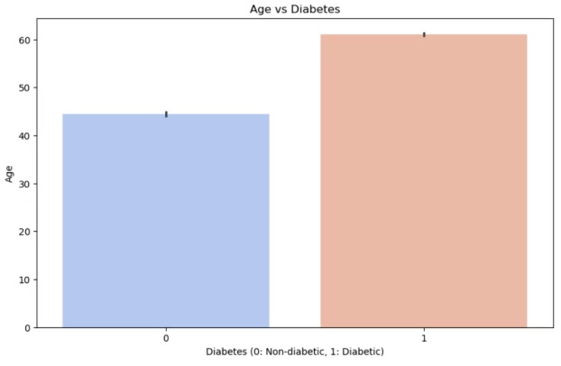
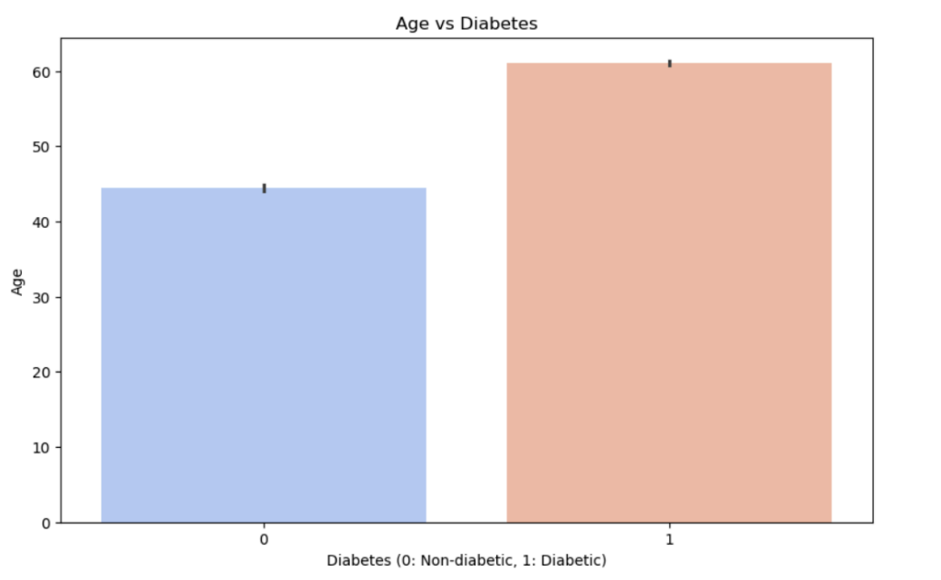
Gender and Age Analysis
The dataset contains more females than males. Among females, most are non-diabetic, but a significant number are diabetic. For males, the trend is reversed, with more being diabetic than non-diabetic.
Age analysis reveals that the average age of non-diabetic individuals is around 45 years, while for diabetic individuals, it's significantly higher at around 60 years. This indicates a clear trend of diabetes being more prevalent in older individuals.
Gender Distribution
Age Analysis
More females than males in dataset
Non-diabetic average: 45 years
Females: Mostly non-diabetic
Diabetic average: 60 years
Males: More diabetic than non-diabetic
Clear trend of higher diabetes prevalence in older individuals

Slide 6
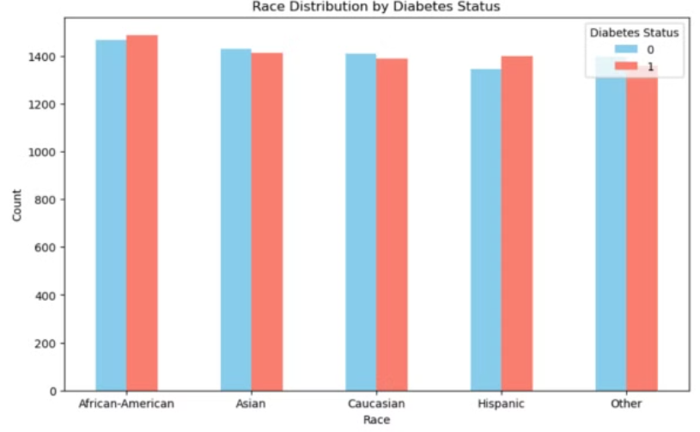
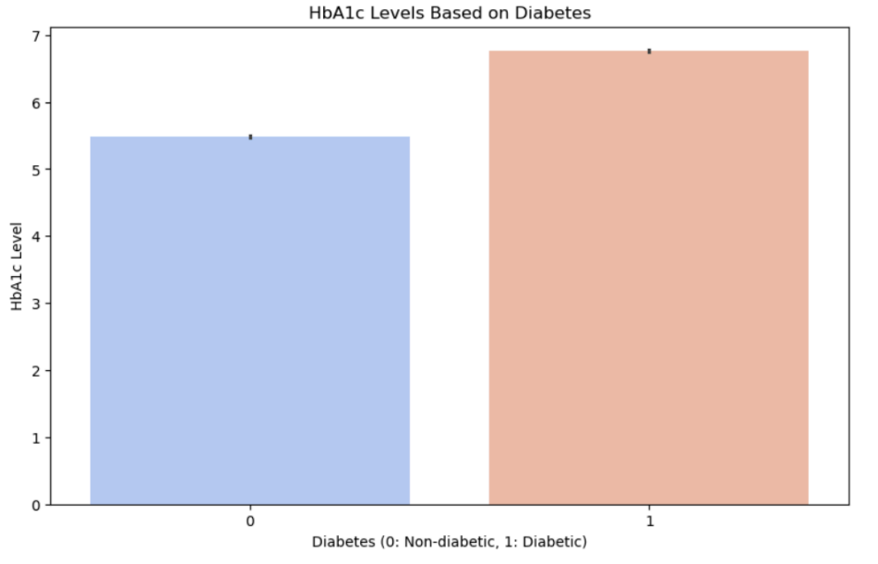
Race and Health Factors Analysis
The dataset shows a balanced representation across racial groups (African-American, Asian, Caucasian, Hispanic, and Other). In all racial categories, there are more non-diabetic individuals than diabetic ones, suggesting relatively consistent diabetes prevalence across races.
Analysis of health factors reveals that diabetic individuals have significantly higher HbA1c levels (around 7) compared to non-diabetics (around 5.5). Hypertension and heart disease are more prevalent among diabetic individuals, indicating a correlation between these conditions and diabetes.
Racial Distribution
Health Factors
Balanced representation across racial groups, consistent diabetes prevalence
Higher HbA1c prevalence in diabetics

Slide 7
Models Implemented
DECISION TREE
A supervised learning algorithm that constructs a tree-like model of decisions based on feature values to make predictions.
RANDOM FOREST
An ensemble learning method that combines multiple decision trees to improve the accuracy and robustness of the model.
XGBOOST
A gradient boosting algorithm that uses a tree-based learning model to provide state-of-the-art performance on a wide range of problems.
GRADIENT BOOSTING
An ensemble learning method that combines multiple weak models (e.g., decision trees) to create a strong predictive model through an iterative process of gradient descent.
LOGISTIC REGRESSION
A statistical model used for binary classification problems, where the goal is to predict the probability of an instance belonging to a particular class.
K-Nearest Neighbors A simple and intuitive algorithm that classifies a data point based on the majority class of its nearest neighbors. It works by finding the 'k' closest data points (neighbors) to the input data and making predictions based on the most common class among those neighbors.
Naive Bayes A probabilistic classifier based on Bayes' Theorem, which assumes that the features are conditionally independent. Despite its simplicity, Naive Bayes is effective for large datasets and is commonly used for text classification and spam filtering.

Slide 8
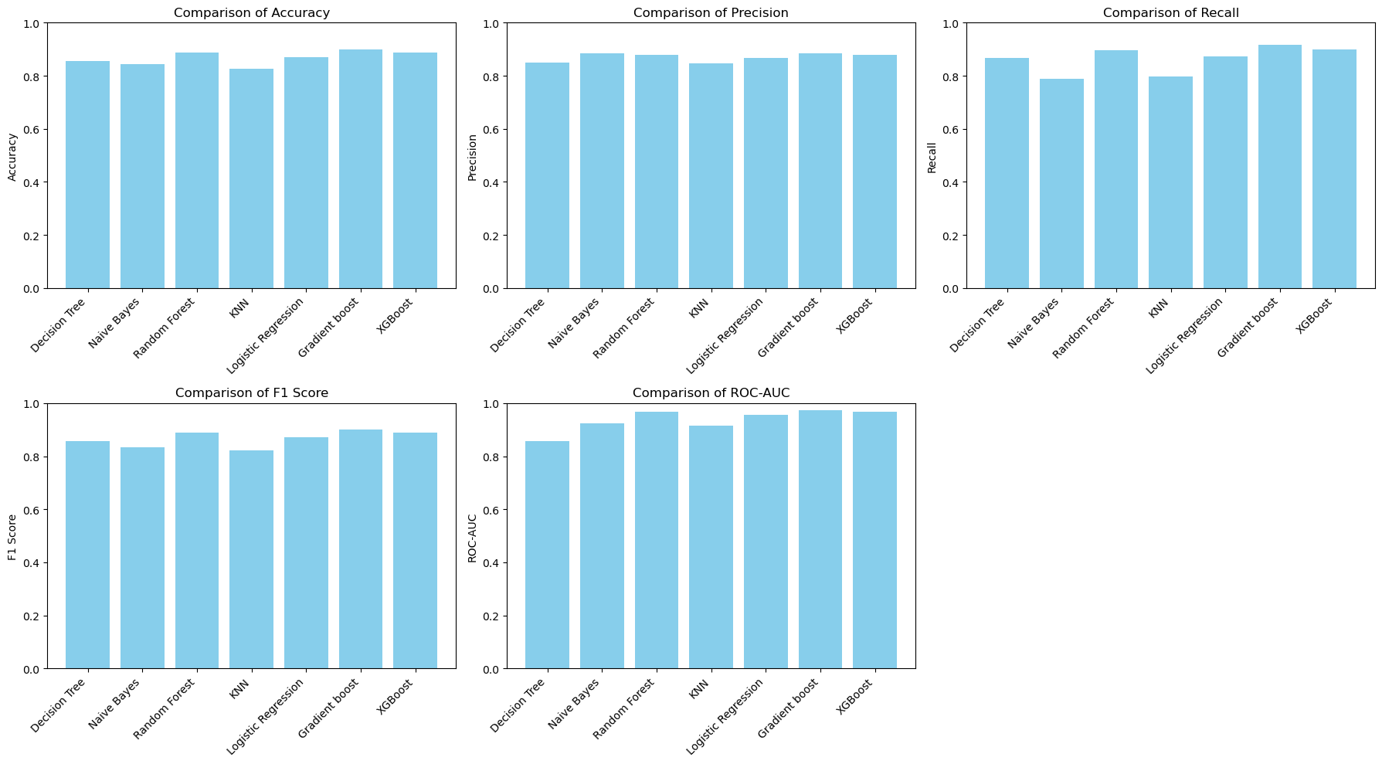
Comparison between metrics according to each model

Slide 9
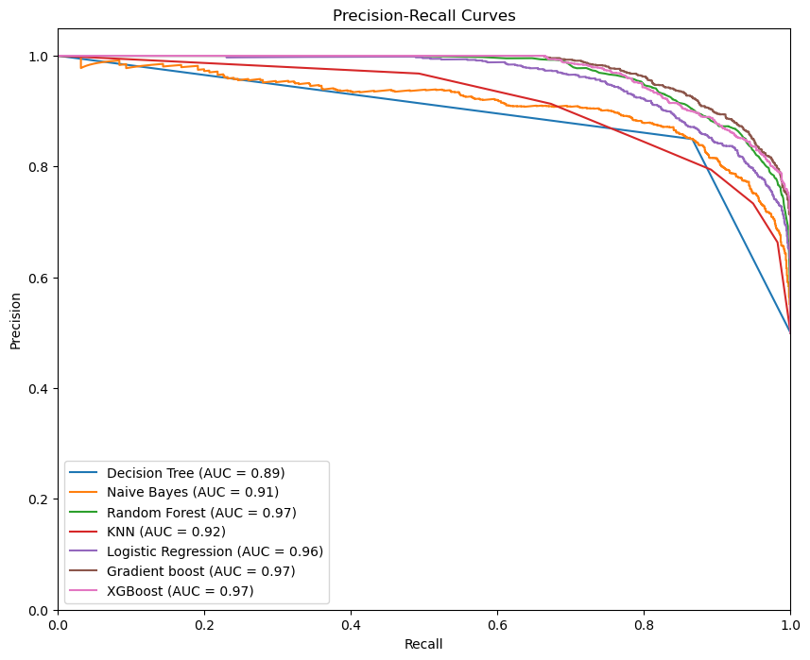
Precision-Recall compassion
AUC-PR: is a measure of the overall performance of a classification model. It is the area under the precision-recall curve, which represents the average precision at different recall levels. A higher AUC-PR indicates better performance. The AUC-PR is a more suitable metric than the AUC-ROC when dealing with imbalanced datasets, where the number of positive and negative examples is significantly different. This is because AUC-ROC can be misleading in such cases, as it may give a high score even if the model performs poorly on the minority class , There is all used Models performance based on this metric

Slide 10



Machine Learning Model Development
After exploring various algorithms, Gradient Boosting was selected as the primary model due to its strong performance, achieving 92% Recall in classifying diabetic and non-diabetic individuals. The model's overall accuracy is 89.89%, with an AUC-PR Score of 97.47%.
Two other models also performed well: XGBoost and Random Forest classifier. The XGBoost model achieved an accuracy of 88.75% and an AUC-PR Score of 97.06%, while the Random Forest Classifier achieved an accuracy of 88.75% and an AUC-PR Score of 96.85%.
Model Accuracy
Recall
AUC-PR Score
Gradient Boosting: 89.89%
Gradient Boosting: 92%
Gradient Boosting: 97.47%

Slide 11
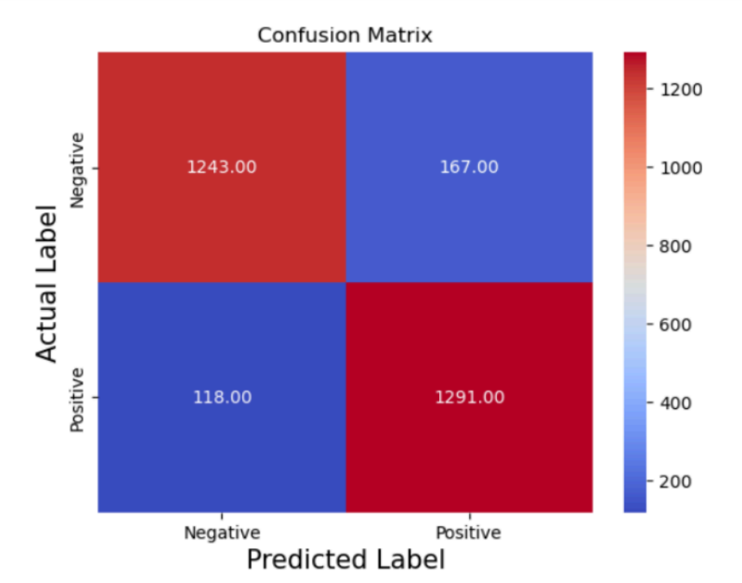

Gradient boosting Confusion Matrix (Best model)
Model Accuracy: 89.89%
AUC-PR Score: 97.47%
Classification Report:
Precision recall f1-score support
0 0.91 0.88 0.90 1410
1 0.89 0.92 0.90 1409

Slide 12
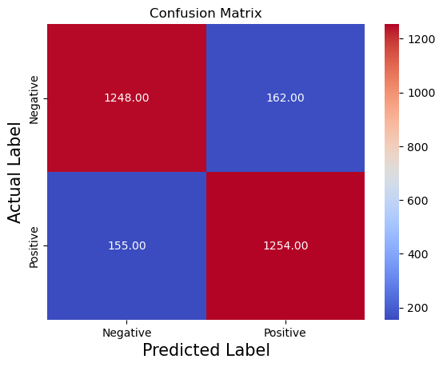

Random Forest Confusion Matrix
Model Accuracy: 88.75%
AUC-PR Score: 96.85%
Classification Report:
precision recall f1-score support
0 0.89 0.89 0.89 1410
1 0.89 0.89 0.89 1409

Slide 13
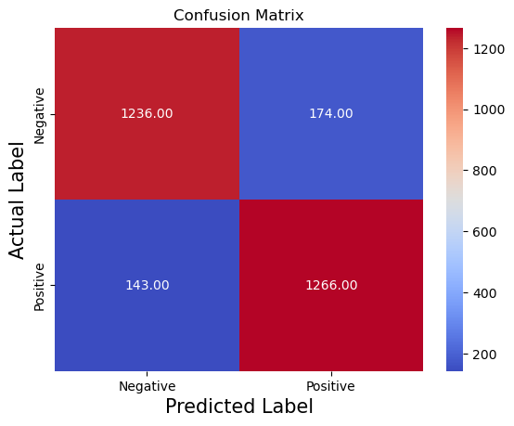

XGBoost Confusion Matrix
Model Accuracy: 88.75%
AUC-PR Score: 97.06%
Classification Report:
precision recall f1-score support
0 0.90 0.88 0.89 1410
1 0.88 0.90 0.89 1409

Slide 14
Thank You!

